Slide 1
RETROFITTING OF BRIDGES BY REPLACING OF OLD BEARINGS WITH ELASTOMER BEARINGS
UNDER THE GUIDENCE OF
MR. Y VINOD
Asst. Professor
Dept. of Civil Engineering
TEAM MEMBERS
T. SAMPATH KUMAR 190029006
B. SAIRAM 190029013

Slide 2
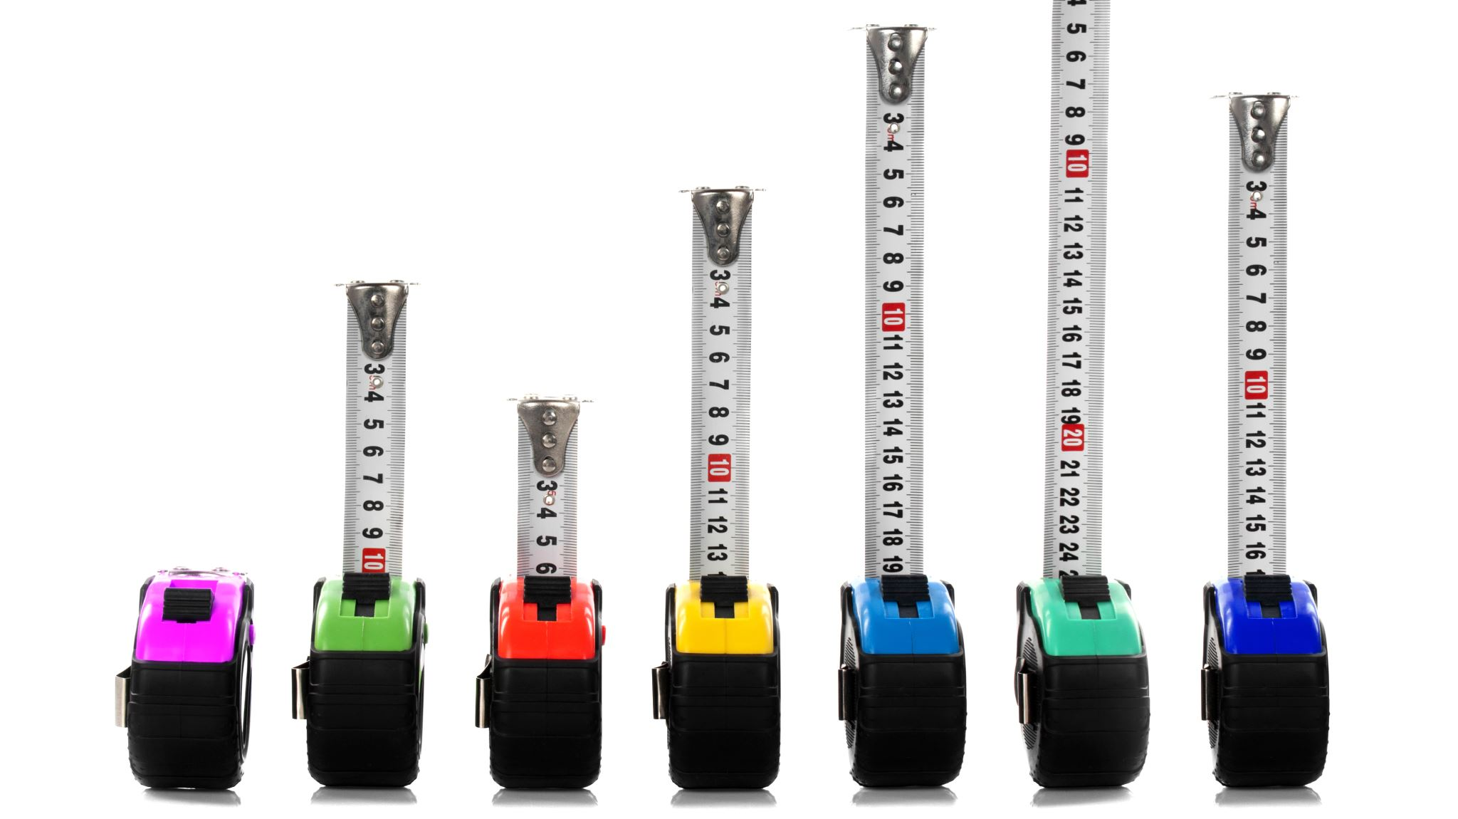
CONTENTS
INTRODUCTION
BEARINGS & IT’S TYPES
LITERATURE REVIEWS
DIMENSIONS OF A MODELLED BRIDGE
LIVE LOAD USED FOR ANALYSING THE BRIDGE
SHEAR FORCE ALONG VERTICAL AXIS
MOMENT ABOUT VERTICAL AXIS
MOMENT ABOUT HORIZANTAL AXIS
BRIDGE STRESS DISTRIBUTION SIMULATION
REFERENCES

Slide 3
introduction
Retrofitting is the cycle of expansion of new highlights to more established structures, legacy structures, bridges and so forth Retrofitting diminishes the weakness of harm of a current structure.
It expects to make a structure more impervious to stacking and seismic movement.
The retrofitting of bridge might be needed in every one of the parts or might be any of them: superstructure, bearings, substructure and foundations.

Slide 4
bearings OF BRIDGE
A bearing is a component of a bridge which provides a resting surface between bridge deck and the bridge piers/ Abutments.
A bridge bearing carries the loads and movement in both horizontal and vertical directions from the bridge superstructure and transfers the loads to the bridge abutments and piers.
The most popular bearings are Elastomeric bridge bearings used.

Slide 5
Types of bearings
Roller bearings:- In this type of bearing longitudinal movement is allowed and rotation, transverse movement is to be prevented.
Elastomeric bearing:- Elastomeric bearing are generally plain elastomeric pads with steel sheet reinforcement depending on design.
Fixed or Clamped bearings:- This type of bearing allows rotation but no longitudinal or transverse movement.
Hinged or pinned bearing:- In this type of bearing rotational movement is permitted and longitudinal movement is prevented

Slide 6
Literature reviews
S.No | DATE | AUTHOR’S | TITLE | REMARK’S
1 | 1/6/2020 | Xu Chen , Chunxiang Li | Seismic performance of tall pier bridges retrofitted with lead rubber bearings and rocking foundation | 1. This paper discuss about the superstructure of bridge is truly situated on flexible bearing without proper maintenance, and the is a high chance of earth quake in this region 2.The model bridge is retrofitted with lead versatile bearing (LRBs) and rocking foundations
2 | 9/7/2003 | M. Dicleli , M.Y. Mansour | Seismic retrofitting of highway bridges in Illinois using friction pendulum seismic isolation bearings and modelling procedures | 1. In this paper, the moderate and essential capability of friction pendulum seIsmic isolation bearings(FPB) for retrofitting regular seismically ineffective bridges in Illinois. 2. He decided seismic solicitations were differentiated and the surveyed furthest reaches of the bridge sections to choose those that should be retrofitted. It was found that the heading, wingwalls and pier foundations of the considered normal bridge should be retrofitted

Slide 7
Literature reviews
S.No | DATE | AUTHORS | TITLE | REMARKS
3 | 15/08/2019 | Muhammad Fawad , K. Kalman , R.A. Khushnood , Muhammad Usman | Retrofitting of damaged reinforced concrete bridge structure | 1. An reliable issue of a current 50 years old regular box-support bridge (Hungary) of 138m length, is damaged . 2. In the current assessment of bridge, steel plate bracing and FRP strip revitalizing/retrofitting have been suggested
4 | 15/11/2019 | Teng Tong, Siqi Yuan, Weiding Zhuo, Zhiqi He,Zhao Li | Seismic retrofitting of rectangular bridge piers using ultra-high performance fiber reinforced concrete jackets | This paper explains an innovative seismic retrofitting system for a reinforced concrete (RC) bridge piers was proposed, by using very ultra high performance fiber reinforced concrete (UHPFRC) jackets. The jackets reduced the strong damage and developed sesmic resistance of a RC pier

Slide 8
Dimensions of Modelled bridge
No. of Spans:- 3
Length of a span:- 25m
Width of a bridge:- 10m
No. of Lane :- 2
Width of median :- 0.3m
Total width :- footpath width + lane 1 + width of median + lane 2 + footpath width
1.25m+ 3.6m + 0.3m + 3.6m + 1.25m = 10m
No. of Longitudinal Girders :- 3
No. of Cross Girders:- 6 [ 2@ supports & 4 @ between the support with spacing 5m c/c]

Slide 9
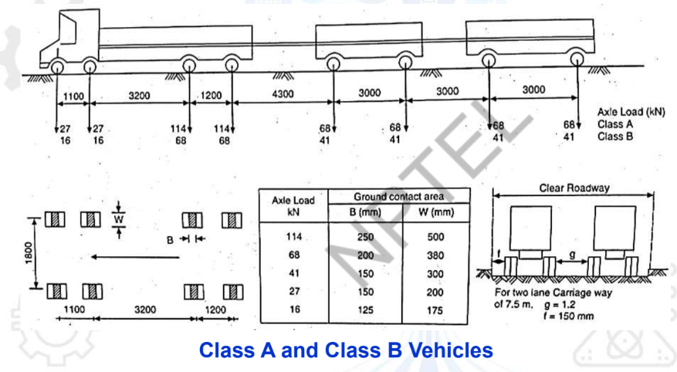
LIVE LOAD USED FOR ANALYSING THE BRIDGE
IRC Class A loading
IRC Class A loading is a 554 kN train of wheeled vehicles on eight axles.

Slide 10
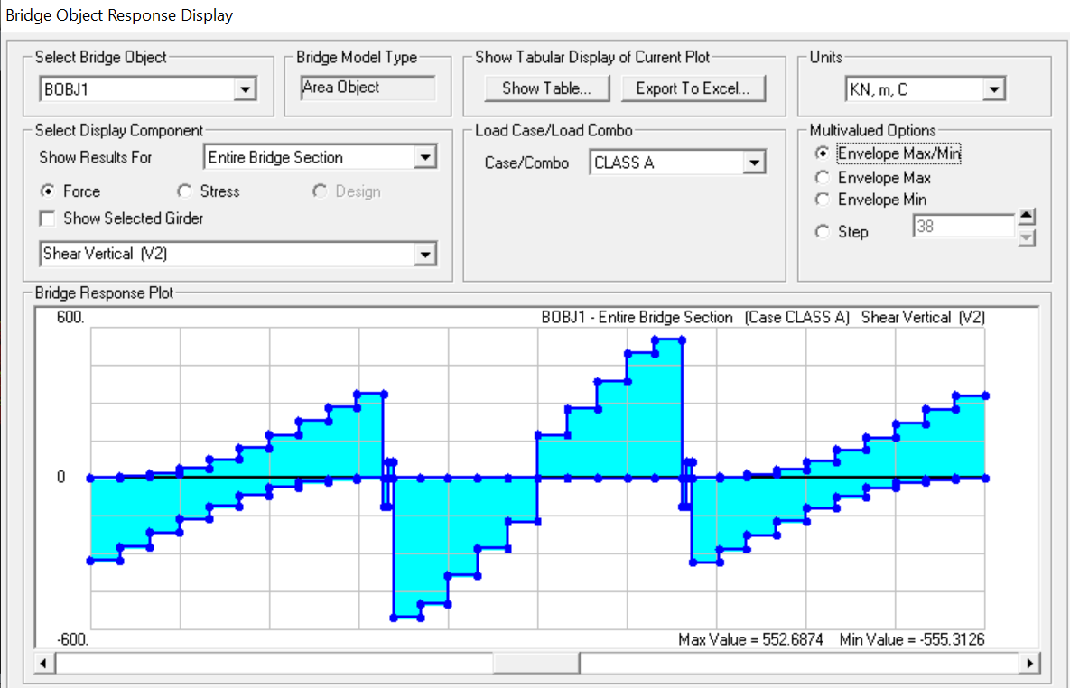
SHEAR FORCE ALONG VERTICAL
MAX SHEAR FORCE
552.63 KN
MIN SHEAR FORCE
-551.315 KN

Slide 11
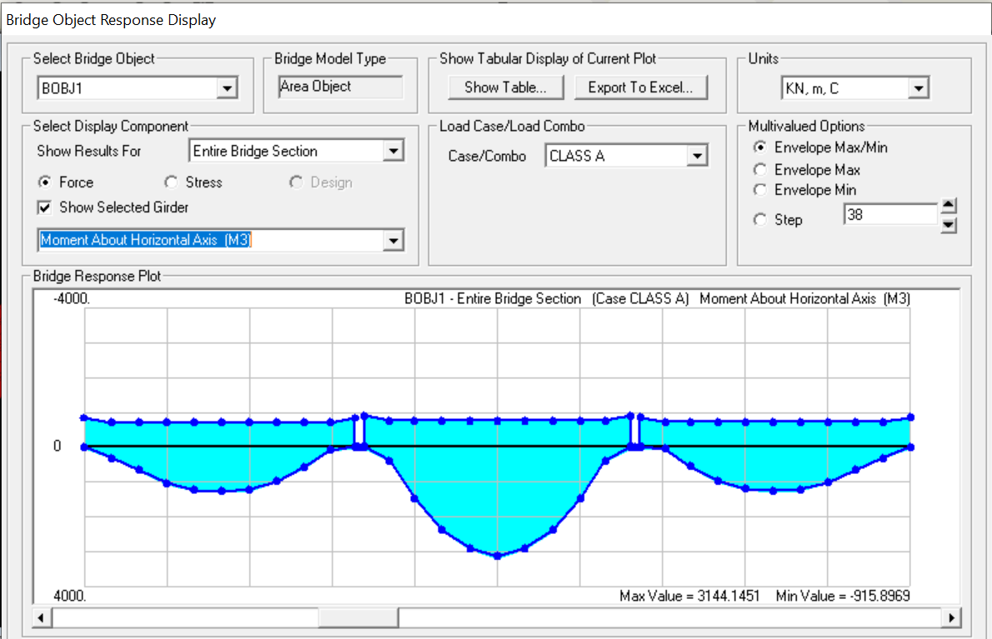
MOMENT ABOUT HORIZANTAL AXIS
MAX VALUE :
3144.51 KN-M
MIN VALUE :
-915.8969 KN-M

Slide 12
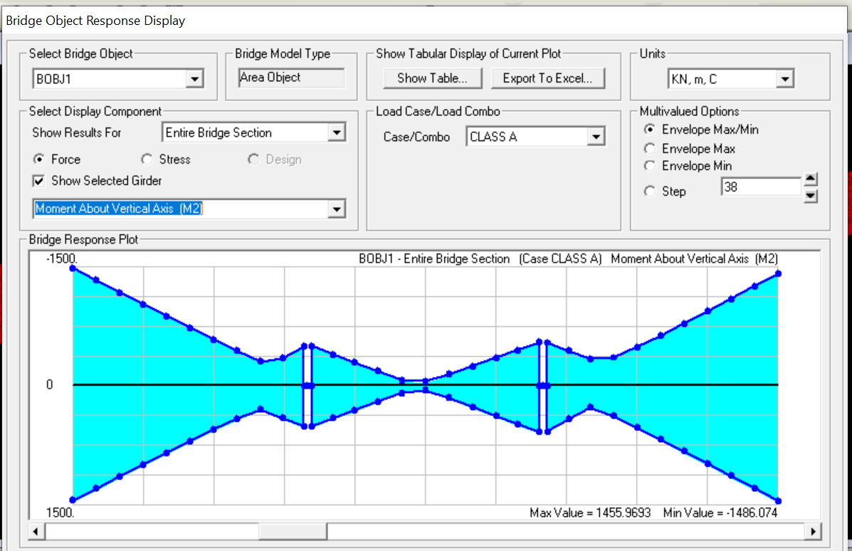
MOMENT ABOUT VERTICAL AXIS
MAX VALUE
1455.96 KN-M
MIN VALUE
-1486.074 KN-M

Slide 13
REFERENCES
Design of bridge structures by T.R. Jagadeesh and M.A. Jayaram
Xu Chen , Chunxiang Li , (2020) “Seismic performance of tall pier bridges retrofitted with lead rubber bearings and rocking foundation.
Huy Binh Pham , Riadh Al-Mahaidi ,(2008) “ Reliablity analysis of bridge beams retrofitted with fibre reinforced polymers”

Slide 14

THANK YOU

